Slide 1
Analysis of the Norwegian economy and forecasts for the years 2010-2020.
Slabtcova Anastasia
2012

Slide 2
Content
1. Problem statement.
2. Fitting of parameters.
3. The result of the identification of models.
4. The baseline forecast.
5. Negative forecast.

Slide 3
1. Problem statement.
$Y\left(t\right)$- gross domestic product (GDP)
$K\left(t\right)$- the volume of capital
$L\left(t\right)$- average number of employees in the country
${Y_{t}=Y_{0}[ {a (\frac{L(t)}{L_{0}}) }^{−b}+ (1−a) {(\frac{K(t)}{K_{0}})}^{−b}]}^{−\frac{c}{b}}$ (1)
Where $Y_{0}>0, L_{0}>0, K_{0}>0, a∈\left(0,1\right), b>−1, c>1$ (at $t$=2000)
${L(t)=ae}^{b(t−2000)}, L(0)=L_{0}$ (2)
$\frac{dK}{dt}= J\left(t\right)−µK\left(t\right), K\left(0\right)= K_{0}$ (3)
Where $J\left(t\right)$- Investments into the fixed capital, µ>0 - the pace of disposal of capital, and $K_{0}$ - initial stock of capital.

Slide 4
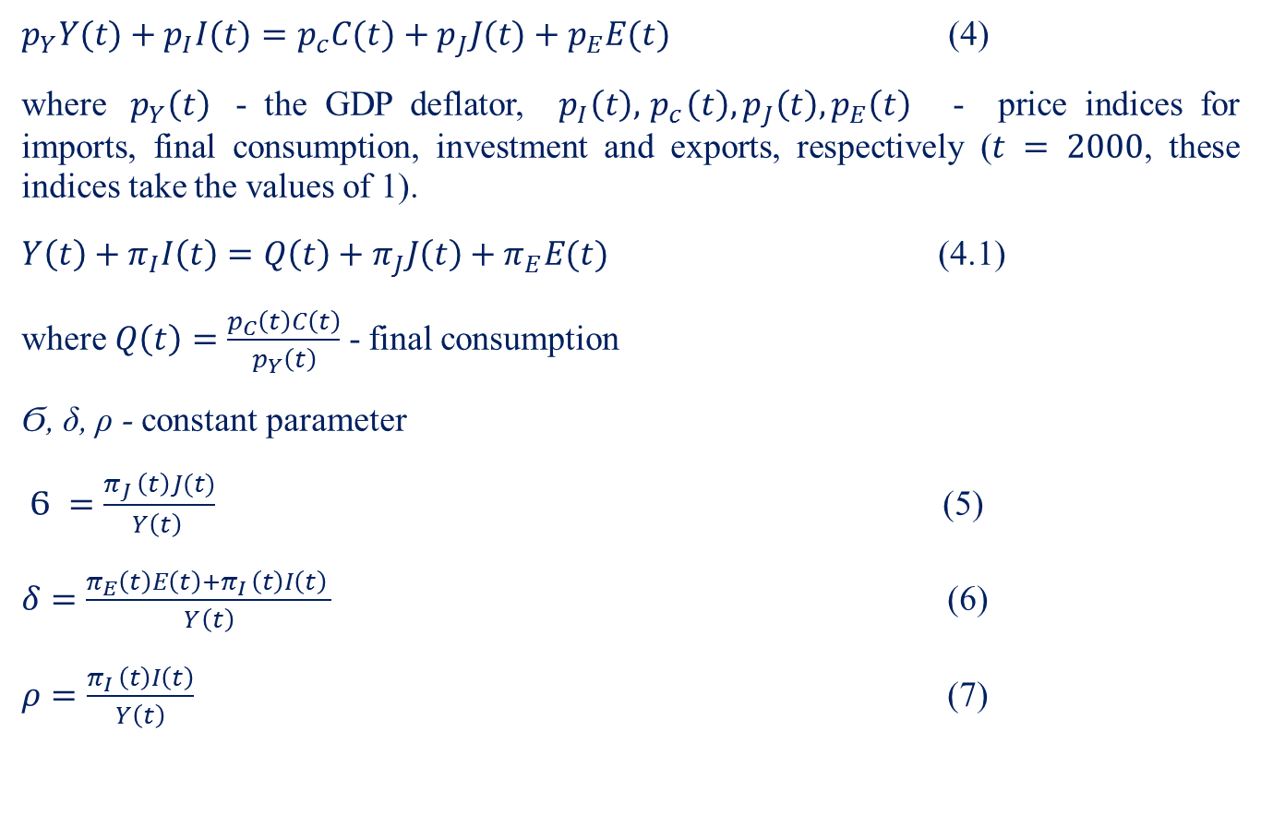
$p_{Y}Y(t)+p_{I}I(t)=p_{c}C(t)+p_{J}J(t)+p_{E}E(t)$ (4)
where ${ p}_{Y}\left(t\right)$ - the GDP deflator, $p_{I}\left(t\right), { p}_{c}\left(t\right), p_{J}\left(t\right), p_{E}\left(t\right)$ - price indices for imports, final consumption, investment and exports, respectively ($t = 2000$, these indices take the values of 1).
${Y\left(t\right)+π}_{I}I\left(t\right)=Q\left(t\right)+π_{J}J\left(t\right)+π_{E}E(t)$ (4.1)
where $Q\left(t\right)=\frac{p_{C}\left(t\right)C\left(t\right)}{p_{Y}\left(t\right)}$ - final consumption
Ϭ, δ, ρ - constant parameter
$Ϭ =\frac{π_{J }\left(t\right)J(t)}{Y\left(t\right) }$ (5)
$δ=\frac{π_{E}\left(t\right)E\left(t\right)+π_{I }\left(t\right)I\left(t\right) }{Y\left(t\right)}$ (6)
$ρ=\frac{π_{I }\left(t\right)I\left(t\right)}{Y\left(t\right)}$ (7)

Slide 5
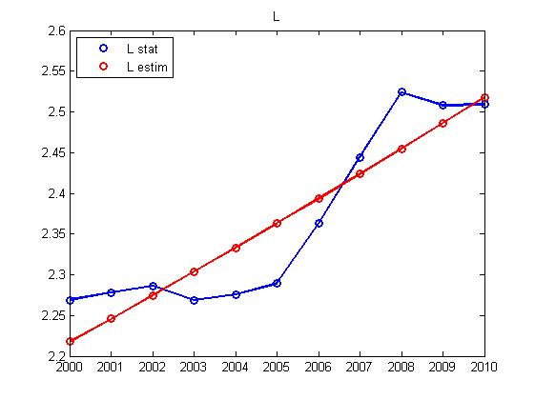
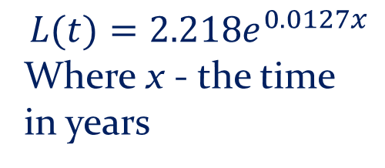
2. Fitting of parameters.
$${L(t)=2.218e}^{0.0127x}$$
Where x - the time in years
Figure 1. Fitting of labor L (t) on the basis of statistical data

Slide 6
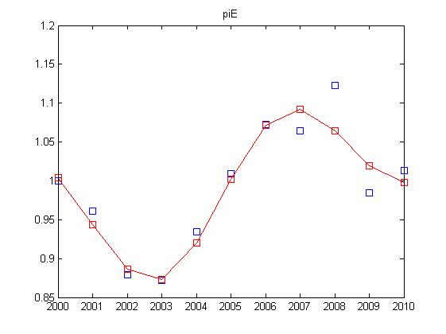
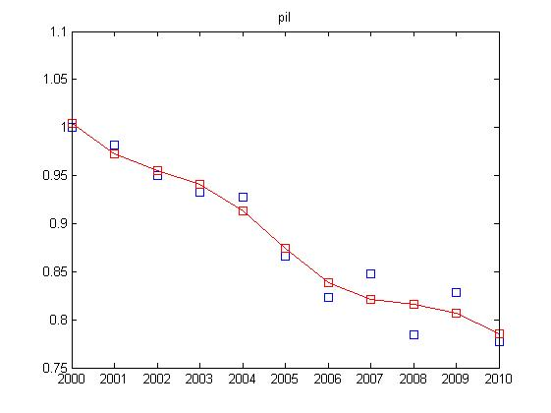
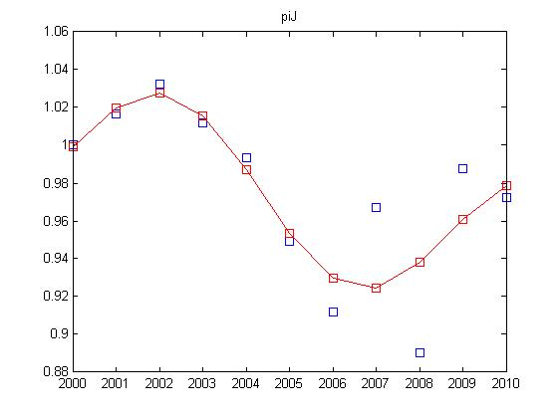
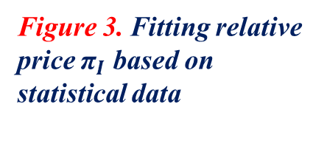
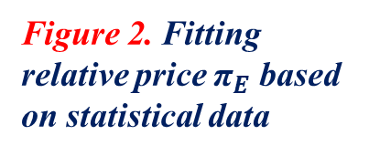
Figure 2. Fitting relative price ${\text{π}}_{E}$ based on statistical data
Figure 3. Fitting relative price ${\text{π}}_{I}$ based on statistical data
Figure 4. Fitting relative price ${\text{π}}_{J}$ based on statistical data

Slide 7
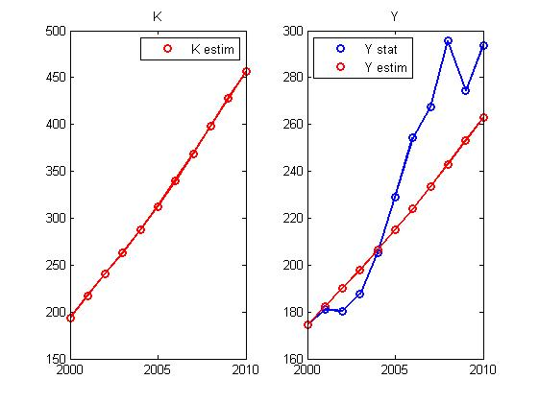
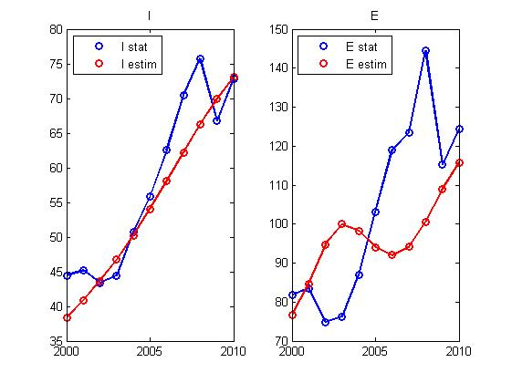
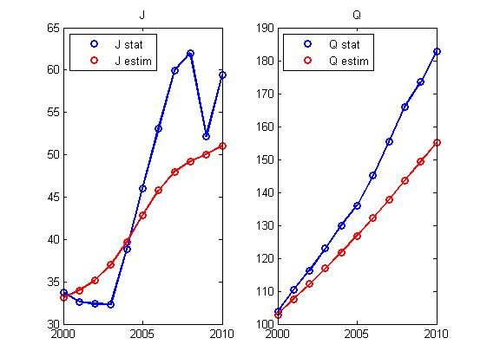
3. The result of the identification of models.
Figure 5. Results for capital K(t) and GDP Y(t)
Figure 6. Results for import s I(t) and exports E(t)
Figure 7. Results for Investments J (t) and final consumption Q (t)

Slide 8
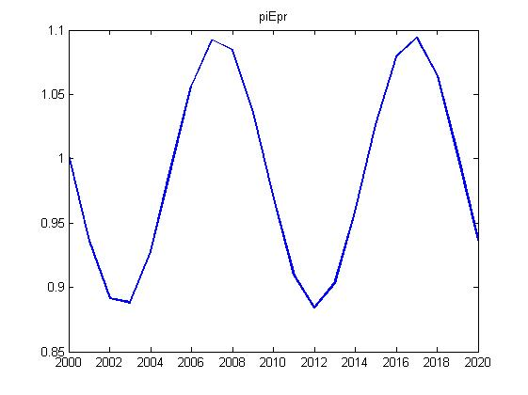
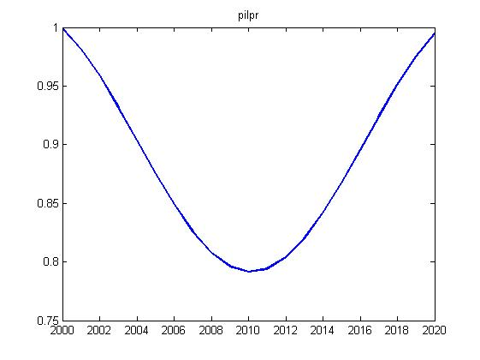
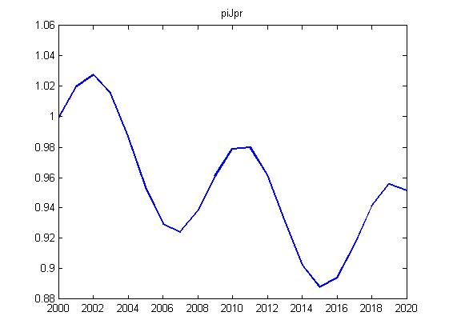
4. The baseline forecast.
Figure 8. Forecast graphic of the relative price index for exports
Figure 9. Forecast graphic of the relative price index for imports
Figure 10. Forecast graphic of the relative price index for investments

Slide 9
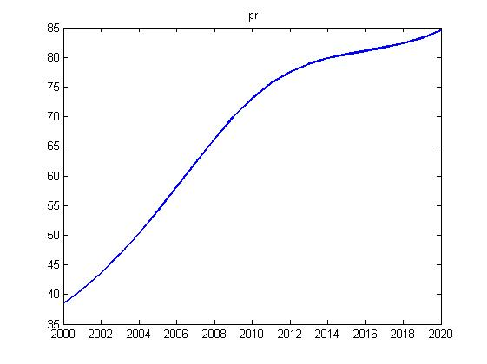
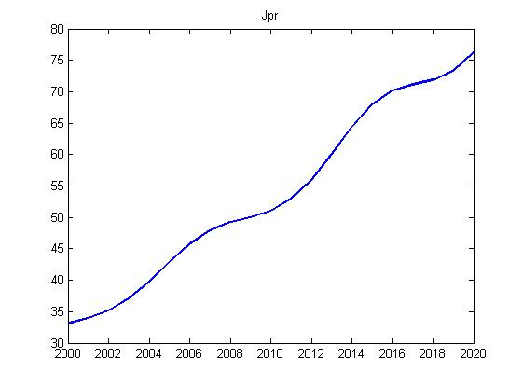
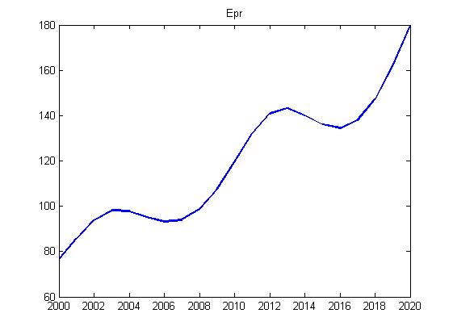
Figure 11. Forecast graphic for imports
Figure 12. Forecast graphic for investments
Figure 13. Forecast graphic for exports

Slide 10
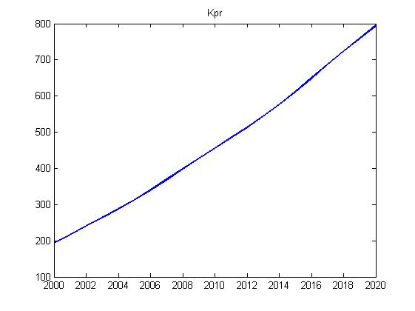
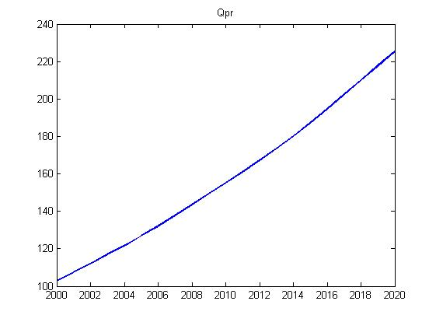
Figure 15. Forecast graphic for final consumption
Figure 14. Forecast graphic for capital

Slide 11
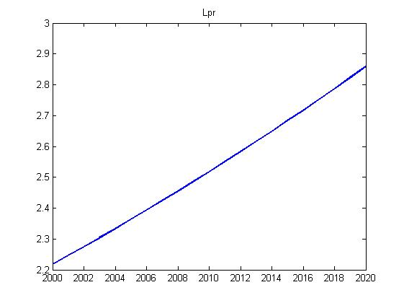
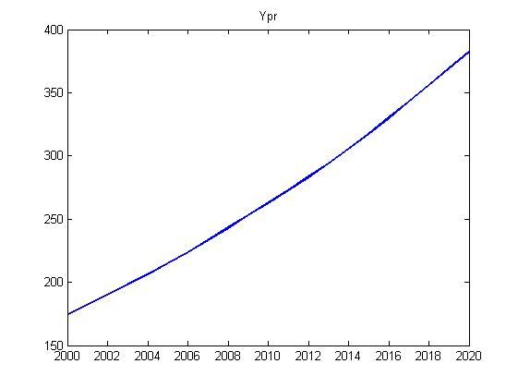
Figure 17. Forecast graphic for GDP
Figure 16. Forecast graphic for labor

Slide 12
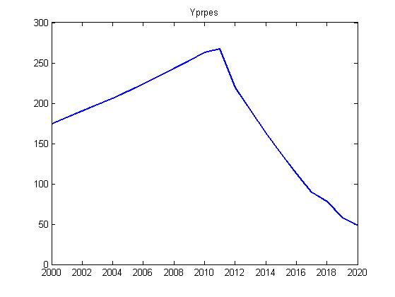
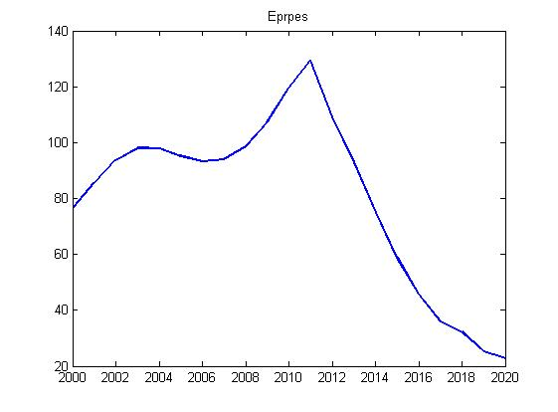
5. Negative forecast.
Figure 19. Negative forecast for exports
Figure 18. Negative forecast for GDP

Slide 13
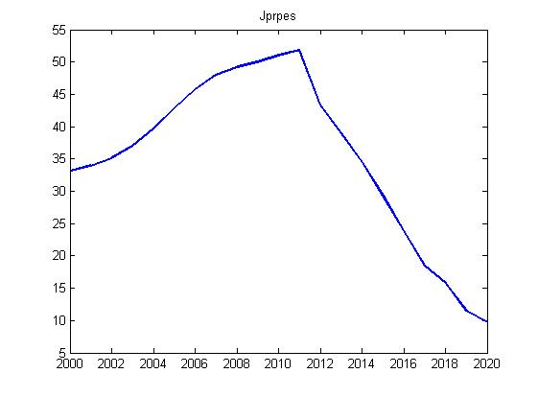
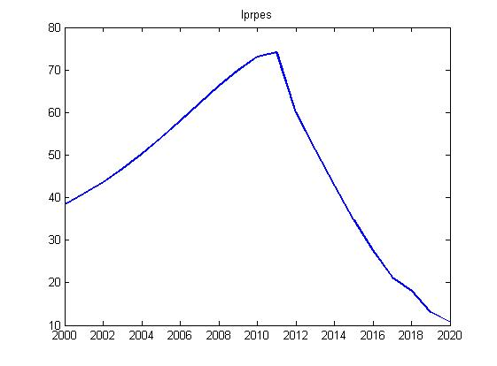
Figure 21. Negative forecast for imports
Figure 20. Negative forecast for investments

Slide 14
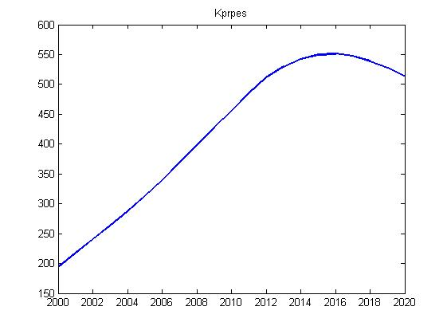
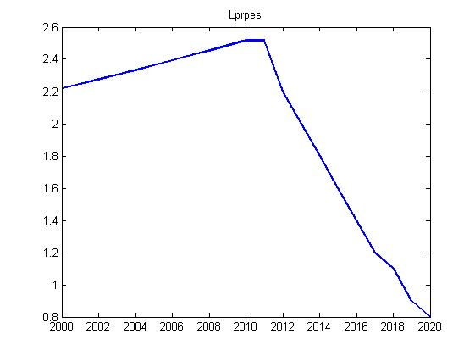
Figure 23. Negative forecast for labor
Figure 22. Negative forecast for capital

Slide 15
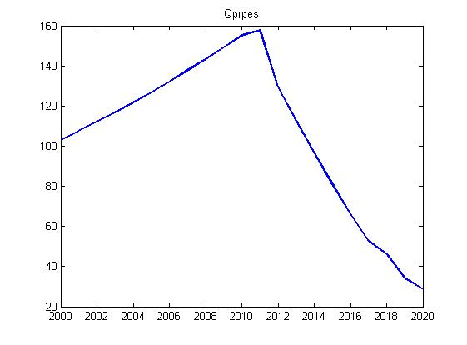
Figure 24. Negative forecast for final consumption

Slide 16
Literature
Оленев Н.Н., Печёнкин Р.В., Чернецов А.М. «Параллельное программирование в MatLab и его приложения», вычислительный центр им.А.А.Дороницына РАН, Москва 2007.
Моисеев Н.Н. Простейшие математические модели экономического прогнозирования. М.: Знание, 1975
Иванилов Ю.П., Лотов А.В. Математические модели в экономике. М.: Наука, 1979. 304 с.
Тейл Г. Экономические прогнозы и принятие решений . М.1971.488с.
http://www.economywatch.com/economic-statistics/country/Norway/
http://dictionary-economics.ru/
http://matlab.exponenta.ru/curvefitting/function_2_2.php
http://matlab.exponenta.ru/curvefitting/3_6.php
http://www.mcds.ru/default.asp?Mode=Review&ID_L0=6&ID_L1=55&ID_L2=546&ID_L3=3847&ID=&ID_Review=61878

