Slide 1
IDENTIFICATION OF THE DYNAMIC MODEL OF THE ECONOMy OF ITALY
Khusainova Elvina

Slide 2
Content:
Problem Definition
Adjustment of parameters
Numerical implementation and identification
Graphical illustrations
Forecasting

Slide 3
Problem definition

Slide 4
Problem formulation
Let the gross domestic product (GDP) Y (t) is determined by a homogeneous production function (1) of the volume of capital (capital stock of the country) K (t) and labor (average annual number of employees in the country) L (t).We assume that labor changes as (2). Further we assume that the capital (the effective value of productive assets) K (t) changes as (3), where $μ$ is an outflow of capital.
$Y\left(t\right)={Y_{0}\left[a{\left(\frac{L(t)}{L_{0}}\right)}^{−b}+(1−a) {\left(\frac{K(t)}{K_{0}}\right)}^{−b}\right]}^{−\frac{c}{b}}$ , (1)
$L=a{(t−1999)}^{b}+c, L\left(0\right)=L_{0}$, (2)
$\frac{dK}{dt}=J\left(t\right)−μK(t), K\left(0\right)=K_{0}$, (3)

Slide 5
Problem formulation
We assume that at each time t the following main macroeconomic balance in the current prices of 2000 is held, where $p_{Y}$(t) - the GDP deflator, $p_{I}$(t) , $p_{C}$(t) , $p_{J}$(t), $p_{E}$(t) - price indices for imports, final consumption, investment and exports, respectively. At t = 2000, these indices take the value 1.
$p_{Y}Y\text{(}\text{t}\text{)+}p_{I}\text{I}\text{(}\text{t}\text{)=}p_{C}\text{C}\text{(}\text{t}\text{)}\text{+}p_{J}\text{J}\text{(}\text{t}\text{)+}p_{E}\text{E}\text{(}\text{t}\text{)}$
Let $Q=\frac{p_{c}C(t)}{p_{Y}(t)}$ , then we have:
Y(t)+$p_{I}\text{I}\text{(}\text{t}\text{)=}\text{Q}\text{(}\text{t}\text{)+}p_{J}\text{J}\text{(}\text{t}\text{)+}p_{E}\text{E}\text{(}\text{t}\text{)}$ (4)

Slide 6
Problem formulation
In order to solve the system (1) - (4) we find exports E (t), imports I (t) and investment J (t) at constant prices of 2000, believing that they are determined by the constant parameters Ϭ, δ, ρ. These parameters are selected from the statistical data by the formulas:
$σ=\frac{π_{J }\left(t\right)J(t)}{Y\left(t\right)+ π_{I }\left(t\right)I\left(t\right)},$
$δ=\frac{π_{E}\left(t\right)E\left(t\right) }{Y\left(t\right)},$
$ρ=\frac{π_{J }\left(t\right)J\left(t\right)+ π_{I }\left(t\right)I\left(t\right)}{Y\left(t\right)−π_{J }\left(t\right)J\left(t\right)},$
As the permanent of $σ$, $δ$, ρ we take the average value for each parameter over the years.: Ϭ = 0,16 ,δ = 0,25 , ρ = 0,56

Slide 7
Problem formulation
$π_{E}\left(t\right)E\left(t\right)$ = $δY(t)$
$π_{J }\left(t\right)J\left(t\right)$ = $Y(t)Ϭ(1+\frac{ρ−Ϭ\left(1+ρ\right)}{1+Ϭ\left(1+ρ\right)})$
${π_{I }\left(t\right)I\left(t\right) }_{ }$= $\frac{ρY\left(t\right)−ϬY\left(t\right)\left(1+ρ\right)}{1+Ϭ\left(1+ρ\right)}$

Slide 8
Adjustment of parameters
Based on the statistical data, we define the parameters of the model using method of least squares.

Slide 9
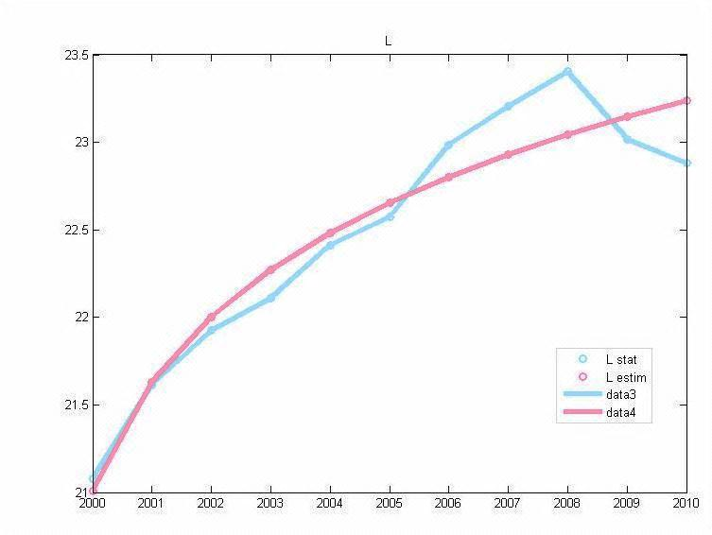
Adjustment of L (employment)

Slide 10
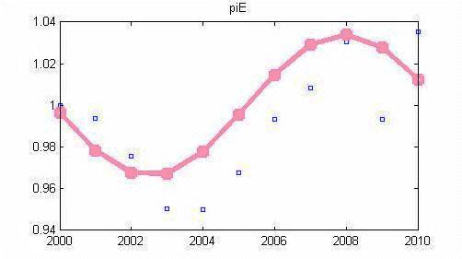
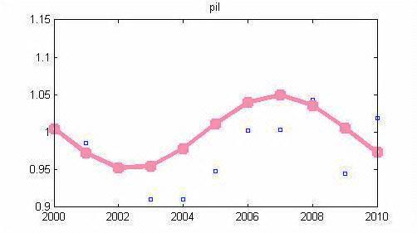
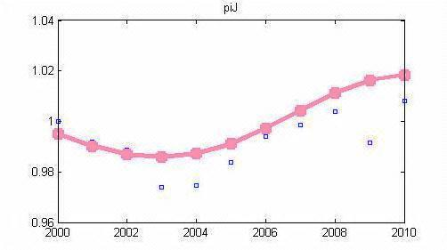
Adjustment of $p_{E},$ $p_{I},$ $p_{J}$

Slide 11
Numerical implementation and identification
Determination of the model parameters
D(X,Y) = $\frac{n{(X}_{t}Y_{t})−(\sum_{t=1}^{n}{X_{t})(\sum_{t=1}^{n}{Y_{t})}}}{\sqrt{\left[nX_{t}X_{t}^{T}−{(\sum_{t=1}^{n}{X_{t})}}^{2}\right] [nY_{t}Y_{t}^{T}−{(\sum_{t=1}^{n}{Y_{t})}}^{2}]}}$

Slide 12
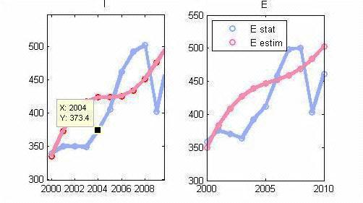
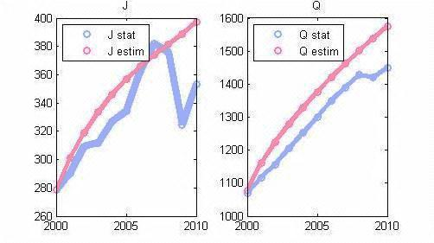
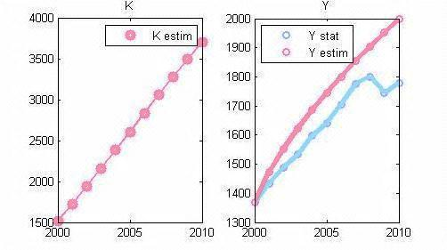
Graphical illustrations of I,E,J,Q,K,Y

Slide 13
Forecasting
Continuing the trend line, identified for the interval 2000-2010 for the major macroeconomic indicators, we can see how the economy develops in Italy. We begin with identifying these values ​​for the relative price indices and draw their graphics. Then we define the forecast for the major macroeconomic indicators.

Slide 14
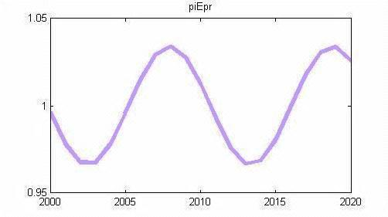
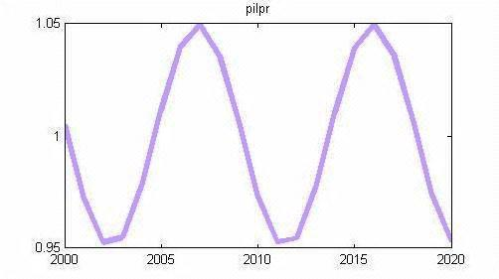
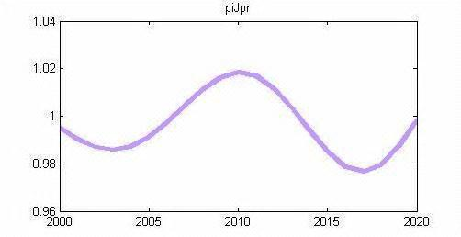
Forecasting of $p_{E},$ $p_{I},$ $p_{J}$

Slide 15
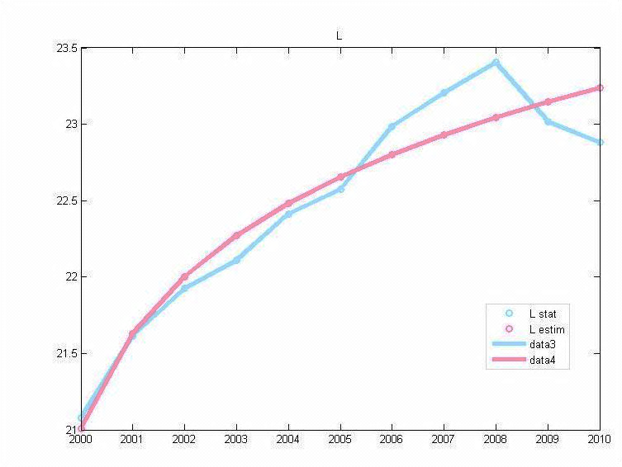
Forecasting of L (employment)
massive youth unemployment
high chronic unemployment
Adjustment of L (employment)

Slide 16
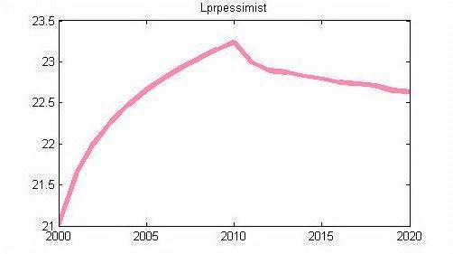
Basic scenario for L (employment)

Slide 17
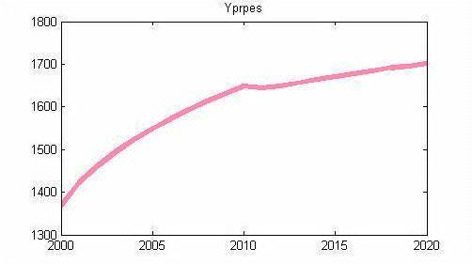
Real scenario for Y (gross domestic product)

Slide 18
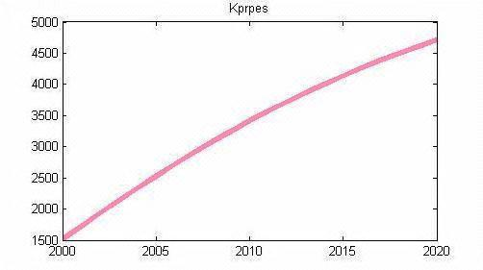
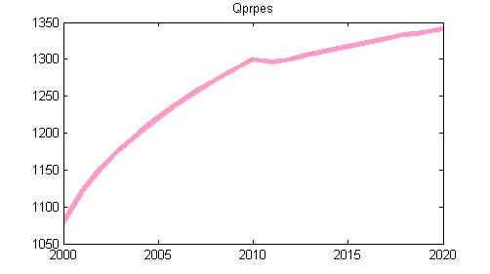
Real scenarios for K, Q

Slide 19
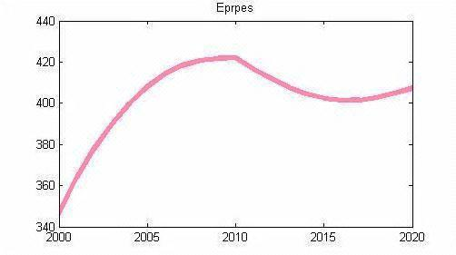
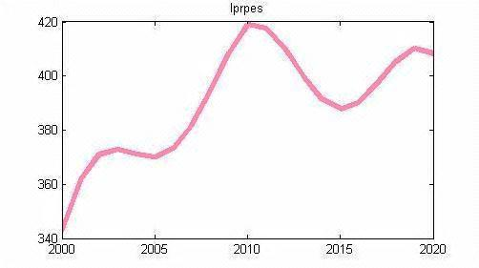
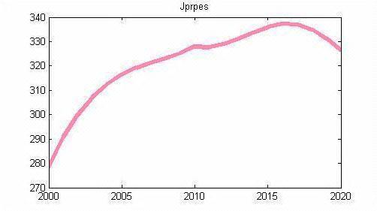
Real scenarios for E,I,J

Slide 20
Growth scenario
Alignment of the economically underdeveloped areas of the South and industrial North
Carrying out the demographic reform
Raising the retirement age to 62 years for women and to 66 for men
Regulation of the migration process

Slide 21
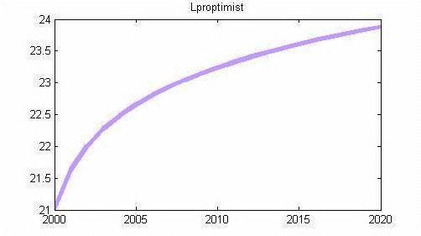
Growth scenario for L (employment)

Slide 22
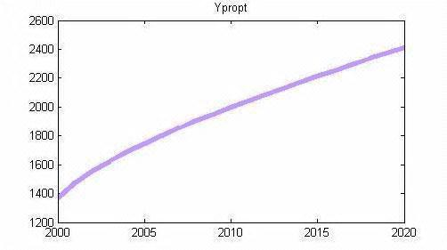
Growth scenario for Y (gross domestic product)

Slide 23
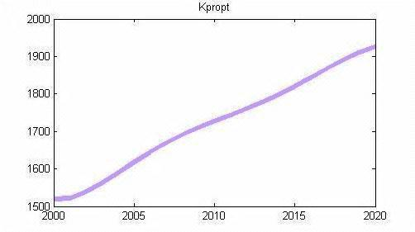
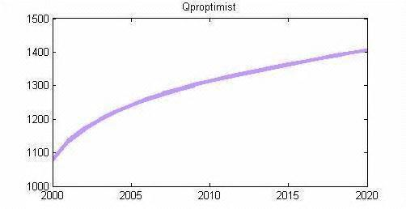
Growth scenario for K, Q

Slide 24
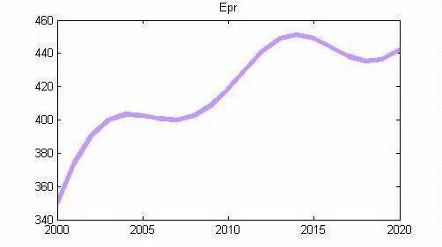
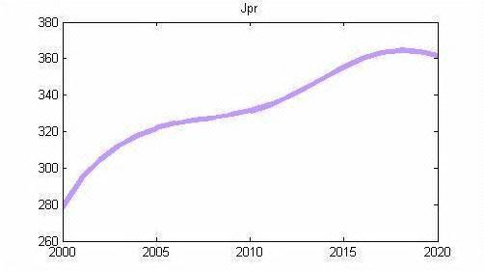
Growth scenario of E, I, J

Slide 25
Literature
N.N.Olenev, R.V.Pechenkin, A.M.Chernetsov "Concurrent Programming in MatLab andits applications," Computer Centre im.A.A.Doronitsyna Academy of Sciences, Moscow 2007.
Intriligator M. Mathematical methods of optimization and economic theory. M.: Iris Press, 2002. 576 p. NN Moiseev The simplest mathematical model of economic forecasting. M.: Knowledge, 1975
http://www.istat.it/it/
http://matlab.exponenta.ru/curvefitting/function_2_2.php
http://matlab.exponenta.ru/curvefitting/3_6.php
Theil H. Economic forecasts and decision making. M.1971.488s.

Slide 26
Литература
Н.Н.Оленев, Р.В.Печёнкин, А.М.Чернецов «Параллельное программирование в MatLab и его приложения», вычислительный центр им.А.А.Дороницына РАН, Москва 2007.
Интрилигатор М. Математические методы оптимизации и экономическая теория. М.: Айрис-пресс, 2002. 576 с.
Моисеев Н.Н. Простейшие математические модели экономического прогнозирования. М.: Знание, 1975
http://www.istat.it/it/
http://matlab.exponenta.ru/curvefitting/function_2_2.php
http://matlab.exponenta.ru/curvefitting/3_6.php
Тейл Г. Экономические прогнозы и принятие решений . М.1971.488с.

